Slide 1
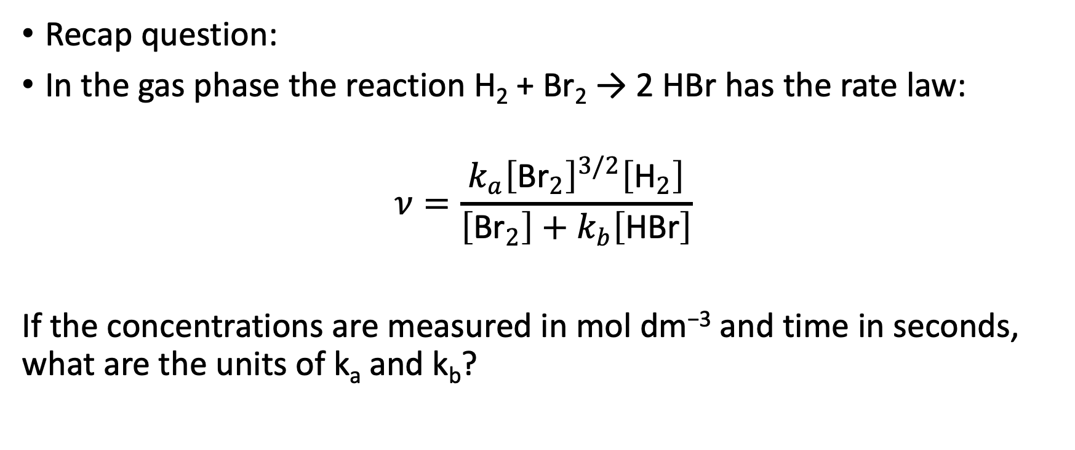
Workshop 2
Recap question:
In the gas phase the reaction H₂ + Br₂ → 2 HBr has the rate law:
$$ν=\frac{k_{a}{\left[{\text{Br}}_{2}\right]}^{3/2}\left[{\text{H}}_{2}\right]}{\left[\text{B}{\text{r}}_{2}\right]+k_{b}\left[\text{HBr}\right]}$$
If the concentrations are measured in mol dm⁻³ and time in seconds, what are the units of k_{a} and k_{b}?

Slide 2
Derive the rate law for the decomposition of N₂O₅:
2N₂O₅(g) → 4NO₂(g) + O₂(g)
on the basis of the following mechanism:
N₂O₅ ⇌ NO₂ + NO₃
NO₂ + NO₃ → NO₂ + O₂ + NO
NO + N₂O₅ → 3NO₂
k_{a}
k’_{a}
k_{b}
k_{c}

Slide 3
Derive the rate law for the production of NO₂:
2N₂O₅(g) → 4NO₂(g) + O₂(g)
on the basis of the following mechanism:
N₂O₅ ⇌ NO₂ + NO₃
NO₂ + NO₃ → NO₂ + O₂ + NO
NO + N₂O₅ → 3NO₂
k_{a}
k’_{a}
k_{b}
k_{c}

Slide 4

$$k=\frac{k_{2}[S]}{[S]+K_{M}}$$
The rate of an enzyme catalysed reaction is given by:
For the following data of rate constant k versus substrate concentration, determine values for the Michaelis constant and k₂ by drawing an appropriate plot
[S] / 10⁻⁶ M | k / s⁻¹
1.1 | 5
3 | 7
9 | 8.2
200 | 9

